Slide 1


Slide 2
Objectives
Learn about the instructors
Overview of Gameful Learning Theory and GradeCraft platform
Review elements of course
Take concept inventory
Touch on the overall themes of the course

Slide 3
Who are we?
Dr. Liv Anderson, Professor
Will teach most of the digestion lectures
Dr. Dave Bridges, Professor
Will teach most of the metabolism lectures
Noura El Habbal, GSI
Will run review sessions
Will teach the lipid oxidation lecture
Notes:
Should be at minute 10 here.

Slide 5
Discussions in the Classroom
This class wants to be a conversation
Some rules
Be aware of how much you are contributing to in-class discussions.
Listen respectfully.
Take pair work or small group work seriously.
Support your statements.
Understand that there are different approaches to solving problems.
Respect others’ right to hold opinions and beliefs that differ from your own.
Make an effort to get to know other students.

Slide 6
Food Rankings
Rank the foods on this handout from best to worst
Discuss your food rankings in groups of 5-6
Introduce yourself to the others in the group
Decide on group rankings, enter on one sheet (take about 10 mins)
Feedback
What are some criteria that your group used to define “good”
What food was the most controversial?
Notes:
Start this at 1:45

Slide 7
What food is healthy?
Percent of nutritionists
saying a food is healthy
Taken from the New York Times Upshot article from July 5, 2016.
https://www.nytimes.com/interactive/2016/07/05/upshot/is-sushi-healthy-what-about-granola-where-americans-and-nutritionists-disagree.html
Percent of all Americans
saying a food is healthy

Slide 8
Technology in the Classroom
Strict technology policy. To eliminate screen time distractions, please no use of:
Laptops
Tablets
Smart phones
Slides will be printed out and distributed at the beginning of class
Notes:
Keep you on task - avoid distracting others around you
I will print lectures each time for you.

Slide 9
iClickers
Purchase and register iClickers
UM Computer Showcase
Buy new or used
Details on syllabus, must register
Utilization of clickers in class include:
Quizzes on required readings
Topic reflections and reviews
Notes:
Quizzes – starting next week at the beginning of each class period to make sure keeping up with reading
Support class discussion and make sure understanding material – not graded but part of participation

Slide 10
The easiest quiz
Press A

Slide 11
What is your favorite game?
Why?
Notes:
Is it easy? What makes you come back to it? Are you good at it?

Slide 12
Gameful Learning
Intrinsic motivation
Make meaningful choices
Be challenged but be able to succeed
Feel connected to those around them
Game concepts
Choices
Taking Risks, and the Freedom to Fail
Recurrent Feedback
Transparency of progress

Slide 13
Differences with Traditional Classes
Normal
Start with 100% and lose points
All students take same path of assessments
Instructor picks due dates
Gameful
Gain points towards grade
You pick their own assignments
You largely choose when to do assignments

Slide 14
Have Your Peers Ever Had a Class Like This?

Slide 15
What have you done before

Slide 16
Assignments
Required assignments are meant to assess foundational knowledge. These include
Midterms
Quizzes
In-class assignments
Optional assignments
Demonstration of Foundational Knowledge | Written Communication | Oral Communication | Peer Interaction and Reflections
Midterms | Written Report | In-Class Presentation | In-Class Assignments
Quizzes | Quora/Wikipedia | Recorded Presentation | News Topic
Review Questions | Reddit | Group Projects | News Discussion
Problem Roulette | Personal Blog |  | Peer Grading of Presentations
 | Instagram/Twitter |  | Presentation Discussions
Notes:
Review Qs submitted on canvas
Describe review session

Slide 17
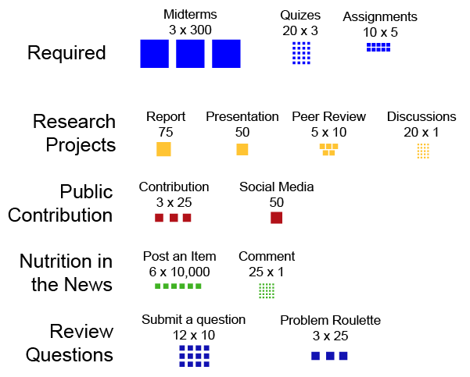
Picking Assignments
Pick and choose based on what is meaningful and effective to your learning
Decide based on your life when you want to do them
Take risks!
Some individual, some in groups
Notes:
Review Qs submitted on canvas
Describe review session

Slide 18
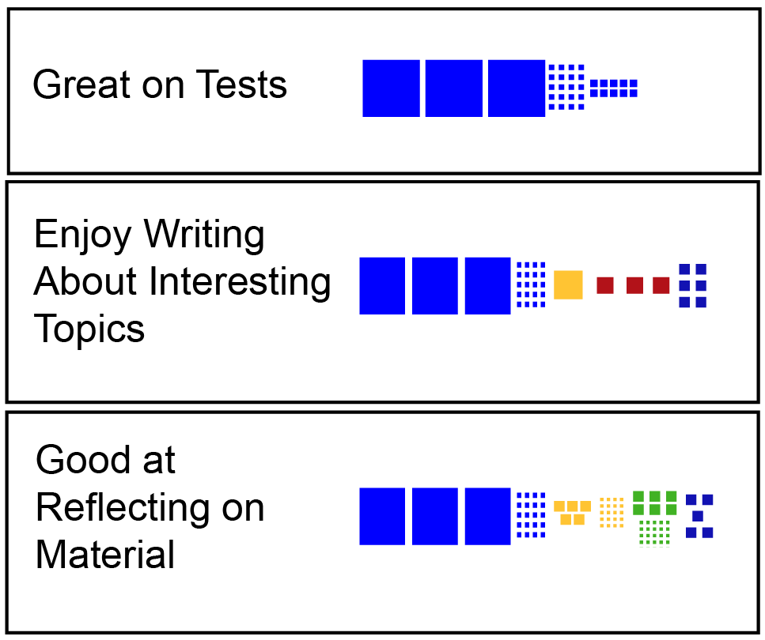
Levels and Grades
1000 points to get an A
Many routes to get to 1000 points
Notes:
Have Rina

Slide 19
Last Year’s Students who earned an A
Darker means more points

Slide 20
Pick Meaningful Assignments!
Notes:
Teaching – presentations, multiple choice questions
Mechanisms – research projects
Explaining – blogs, news critiques

Slide 21
How Many Points Should I Get from Options?

Slide 22
Gameful Learning Advice
Read the summaries of the assignments and think about ones you want to do
Use Grade Predictor to plan out how and when to do assignments → helpful planning tool
Take risks if you are interested, you can always try again!
Broaden your horizons by trying new assignments that may be outside your comfort zone → they may help you score better on exams!

Slide 23
GradeCraft Demo, switch computers!
Finding information about assignments
Using Grade Predictor
What are badges?
Notes:
Things to cover
Reading about assignments
Using Grade Predictor

Slide 24
Make this class your own
Pick assignments that are meaningful to you
Perfect your studying and learning experience by finding a nice coffee shop, a quiet library, working in study groups or studying in a park…
Reach out to us with any questions, concerns or comments. PLEASE!

Slide 25
Making Use of the Handouts
Read the required readings
Canvas is where readings are posted
Also lists extra information, videos, optional assignments
Give yourself some time to identify what is clear and what is unclear
Ask the instructional team for extra materials if you need them
Ask questions in class, or on Piazza
Vocabulary issues - vocabulary page
Review the materials after class
Write multiple choice review questions (Optional assignment)

Slide 26
Questions about this approach?
Should I do all or most of the optional assignments, just in case?
Should I wait until I see how I am doing on the midterms before picking assignments?
What if I have an idea that isn’t reflected in the assignments, or want to do something slightly different?
This seems like a lot of choices and is overwhelming, how should I start?
Some assignments are “locked” how do I enable them?

Slide 27
Concept Inventory
Notes:
10- 15 minutes

Slide 28
Course Goals
Develop in-depth understanding of digestive tract anatomy and process of digestion, absorption and transportation mechanisms
Macronutrient metabolism (carbohydrates, proteins, lipids)
Describe structure and properties
Describe digestion, absorption, transportation
Explain human metabolism
Understand inter-organ mechanisms
Notes:
Bulk of course focuses on 3 macronutrients

Slide 29
What did you say you were excited about?

Slide 30
Which of these macronutrients can we make ourselves and do not need from the diet?
Alanine
Lysine
Omega 6 Fatty acids
Vitamin D

Slide 31
Essentiality, Energy and Efficiency
Essentiality
What can we make? what must we ingest?
Energy from macronutrients
Efficiency of digestion and metabolism

Slide 32
First Optional Assignment - Essentiality
Gastropod podcast on the history of vitamins
Listed under Bonus Assignments on GradeCraft

Slide 33
Next Class – Energy Balance And Appetite
Monday Afternoon
To Do
Read the notes and watch the video
Register for Piazza/GradeCraft if not done already
Plan out your semester using Grade Predictor
Quiz!
Register your iClicker
Quiz based on required readings/videos on Canvas

